Slide 1
An Outline of Cellular Automaton Universe via Cosmological KdV equation
CTPNP, 1 Aug. 2017
V. Christianto, F. Smarandache, Y. Umniyati

Slide 2
A little caution
This is a concept paper (outline)
We will not present results, instead we offer a new insight in cosmology modelling

Slide 3
Our motivation
It is known that there is quantization in astronomy, for example Tifft’s redshift quantization is known since 1990s.
Around 1960s V. Subramaniam suggested a quantized space, although his approach has been entirely forgotten.
Now we consider that quantization in astrophysics phenomena can be explained by discretization in space.

Slide 4
What is cellular automaton?
According to a dictionary:
“one of a set of units in a mathematical model that have simple rules governing their replication and destruction. They are used to model complex systems composed of simple units such as living things or parallel processors.”

Slide 5
Another definition of CA
A cellular automaton (pl. cellular automata, abbrev. CA) is a discrete model studied in computability theory, mathematics, physics, complexity science, theoretical biology and microstructure modeling. ... For each cell, a set of cells called its neighborhood is defined relative to the specified cell.
Source: https://en.wikipedia.org/wiki/Cellular_automaton

Slide 6
A Computing universe?
Konrad Zuse is probably the first scholar who imagine a Computing Universe.
In recent years, there are a few researchers who suggest similar vision in terms of cellular automata, for example Stephen Wolfram, Prof. Gerardus ‘t Hooft, and Robert L. Kurucz from Harvard Smithsonian of Astrophysics.

Slide 7
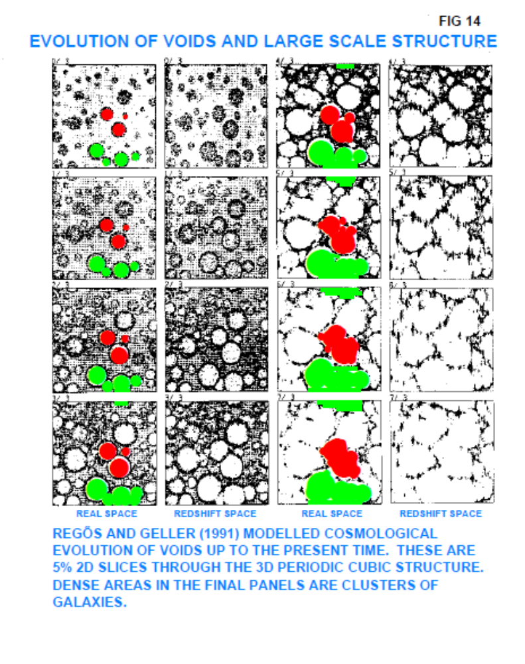
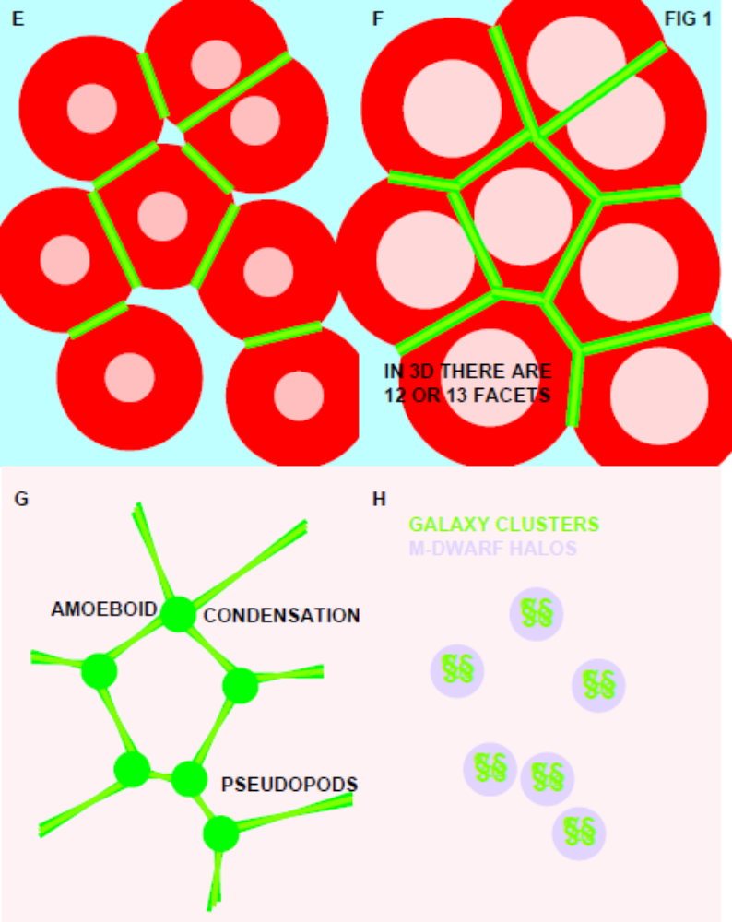
From R. Kurucz (2006), arXiv:astro-ph/0605469

Slide 8
Cosmic sound wave
It has been known for long time that the cosmic sound wave was there since the early epoch of the Universe. Signatures of its existence are abound. However, such a sound wave model of cosmology is rarely developed fully into a complete framework.
question: is it possible to model that cosmic sound wave using soliton as known solution of cosmological KdV equation?

Slide 9
What is Korteweg-deVries equation?
KdV is a non-linear wave equation plays a fundamental role in diverse branches of mathematical and theoretical physics. Its significance to cosmology has been discussed by a number of authors, such as Rosu and recently Lidsey.
It is suggested that the KdV equation arises in a number of important scenarios, including inflationary cosmology etc.

Slide 10
A bit of history of KdV
John Scott Russell, a Scottish naval engineer, reported in 1834 on his observation of a remarkable solitary water wave moving a considerable distance down a narrow channel.
Korteweg and de Vries (1895) developed a theory to describe weakly nonlinear wave propagation in shallow water.

Slide 11
A bit of history
Kruskal and Zabusky (1965) discovered that the KdV equation admits analytic solutions representing what they called "solitons"—propagating pulses or solitary waves that maintain their shape and can pass through one another. These are evidently waves that behave like particles!
Several detailed analyses suggest that the coherence of solitons can be attributed to a compensation of nonlinear and dispersive effects.

Slide 12
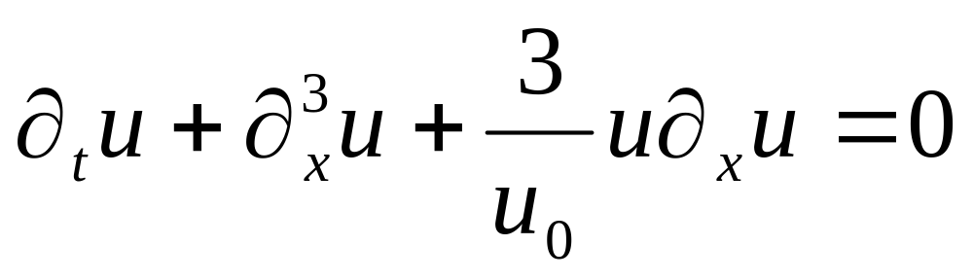
KdV equation
Korteweg-de Vries (KdV) equation is the completely integrable, third-order, non-linear partial differential equation (PDE):
where u = u(x, t), ∂_{t} = ∂/∂t, ∂_{x}³ = ∂³/∂x³, etc., u₀ is a constant and (x, t) represent space and time coordinates, respectively.

Slide 13
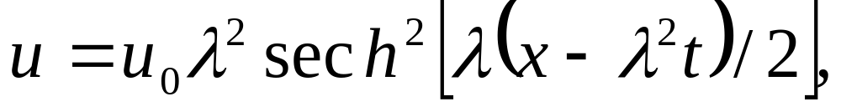
Soliton solution of KdV equation
KdV equation was originally derived within the context of small-amplitude, non-linear water wave theory and it is well known that it admits a solitonic wave solution of the form
where the constant λ/2 represents the wavenumber of the soliton.

Slide 14
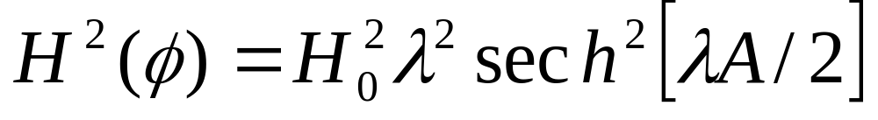
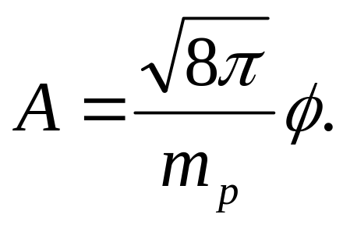
Cosmological KdV equation
It can be shown that Friedmann equation after some steps yields to an equation which takes the form of KdV, as follows:
Where:

Slide 15
CA model of KdV equation
There are several methods to consider discretization of KdV equation into cellular automata models. Here we consider only 3 approaches.
A. Steeb & Hardy’s method:

Slide 16
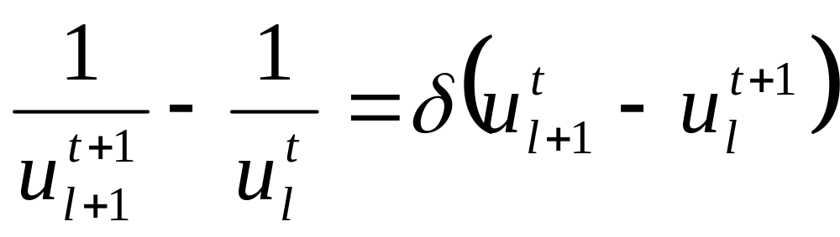
CA model
B. Hirota’s model:
The discrete analogue of the KdV equation is known thanks to the pioneering work of Hirota. It has the form:

Slide 17
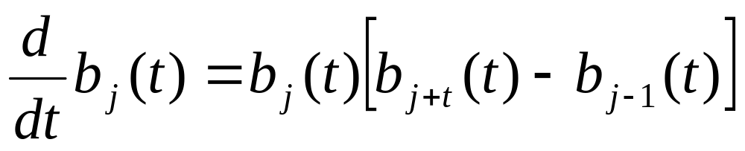
CA model
C. Tokihiro et al.;
They suggested that an integrable discretization (differential-difference equation) of the KdV equation is the Lotka-Volterra equation :

Slide 18
CA Model
In other words, it appears possible at least in theory to consider a Cellular Automaton-KdV Universe, based on discretization of the original KdV equation. Nonetheless, further analysis and numerical simulation is required to study its potential applications.

Slide 19
Concluding remarks
It is our hope that the new proposed equations can be verified with observation data both at lab scale and also at large scale astronomy data.
We also expect that the proposed theoretical models based on CA may offer a clue to answer the great mystery of our Universe: the origins of life. This problem remains missing in most existing physical cosmology models.
Nonetheless, we admit that our model is still in its infancy, more researches are needed to fill all the missing details.

Slide 20
Future Works
We plan to do computational simulation of the proposed CA equations of KdV, and then compare with existing data.
We plan to investigate the role of acoustic soliton to study astrophysical phenomena.
We will also investigate cellular automaton molecular model of elementary particles (the draft paper has been submitted to MDPI-Mathematics Journal).

Slide 21
References
[1] Pain, H.J. 2005. The Physics of Vibrations and Waves. 6th ed. John Wiley & Sons, Ltd. ISBN: 0-470-01295-1(hardback); 0-470-01296-X(paperback). 563 p.
[2] Wayne Hu & Martin White. The cosmic Symphony. Scientific American 2004.
[3] James E. Lidsey. Cosmology and the Korteweg-de Vries equation. arXiv: 1205.5641 [astro-ph.CO]
[4] Robert L. Kurucz. Radiatively-Driven Cosmology in the Cellular Automaton Universe. arXiv:astro-ph/0605469.
[5] Robert L. Kurucz. Elementary Physics in the Cellular Automaton Universe. arXiv:astro-ph/0605467

Slide 22
References
[6] Hendra Adiwidjaja. On the Korteweg-de Vries equation. December 9, 1995. CDS 141 Project
[7] H.C. Rosu. Mod. Phys. Lett. A17, 667 (2002). arXiv: gr-qc/011002
[8] Alwyn C. Scott. The Nonlinear Universe. Berlin Heidelberg: Springer-Verlag, 2007.
[9] S. Wolfram. Cellular Automata and Complexity. Reading, Mass.: Addison-Wesley, 1994.
[10] S. Wolfram. Cellular Automaton fluids: basic theory. http://www.stephenwolfram.com
[11] Willi-Hans Steeb and Yorick Hardy. One Dimensional Cellular Automata, Conservation Laws, and partial Differential Equations. Z. Naturforsch. 62a, 569-572 (2007).
[12] Xin-She Yang & Y. Young. Cellular Automata, PDEs, and Pattern Formation. arXiv: 1003.1983

Slide 23
References
[13] Pedro P.B. de Oliveira & Mauricio Verardo. Representing Families of Cellular Automata Rules. The Mathematica Journal 16 (2014).
[14] Gerard ‘t Hooft. Duality between a deterministic cellular automaton and a bosonic quantum field theory in 1+1 dimensions. arXiv: 1205.4107
[15] T. Tokihiro, et al., From soliton equations to integrable cellular automata through a limiting procedure. Phys. Rev. Lett. Vol. 76 no. 18 (1996)
[16] Ralph Willox, et al. Solving the ultradiscrete KdV equation. Fast track communication. J. Phys. A: Math. Theor. 43 (2010) 482003. (IOP)
[17] Robert L. Kurucz. The Formation of Life. arXiv:astro-ph/0011209 (2000)
[18] S.I. Walker. Origins of Life: A Problem for Physics. arXiv: 1705.08073 (2017)

Slide 24
Thank you so much
Bandung, 1 august 2017
Presented by :
Victor Christianto, DDiv.
Founder of www.ketindo.com
Email: victorchristianto@gmail.com
http://researchgate.net/profile/Victor_Christianto
arXiv:astro-ph/0605469

